Slide 1
ISTD 50.001
Data Analytics for Internet of Things (IoT)

Slide 2
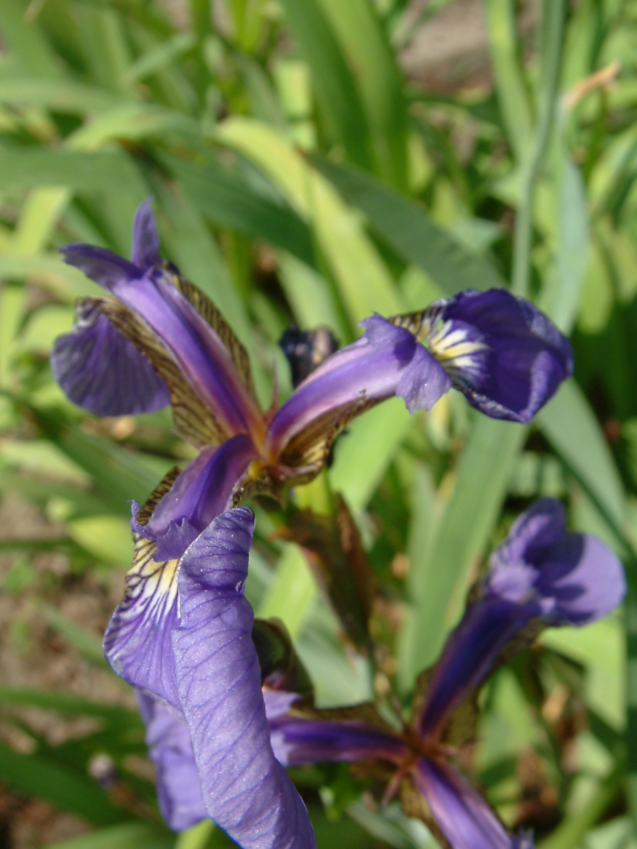
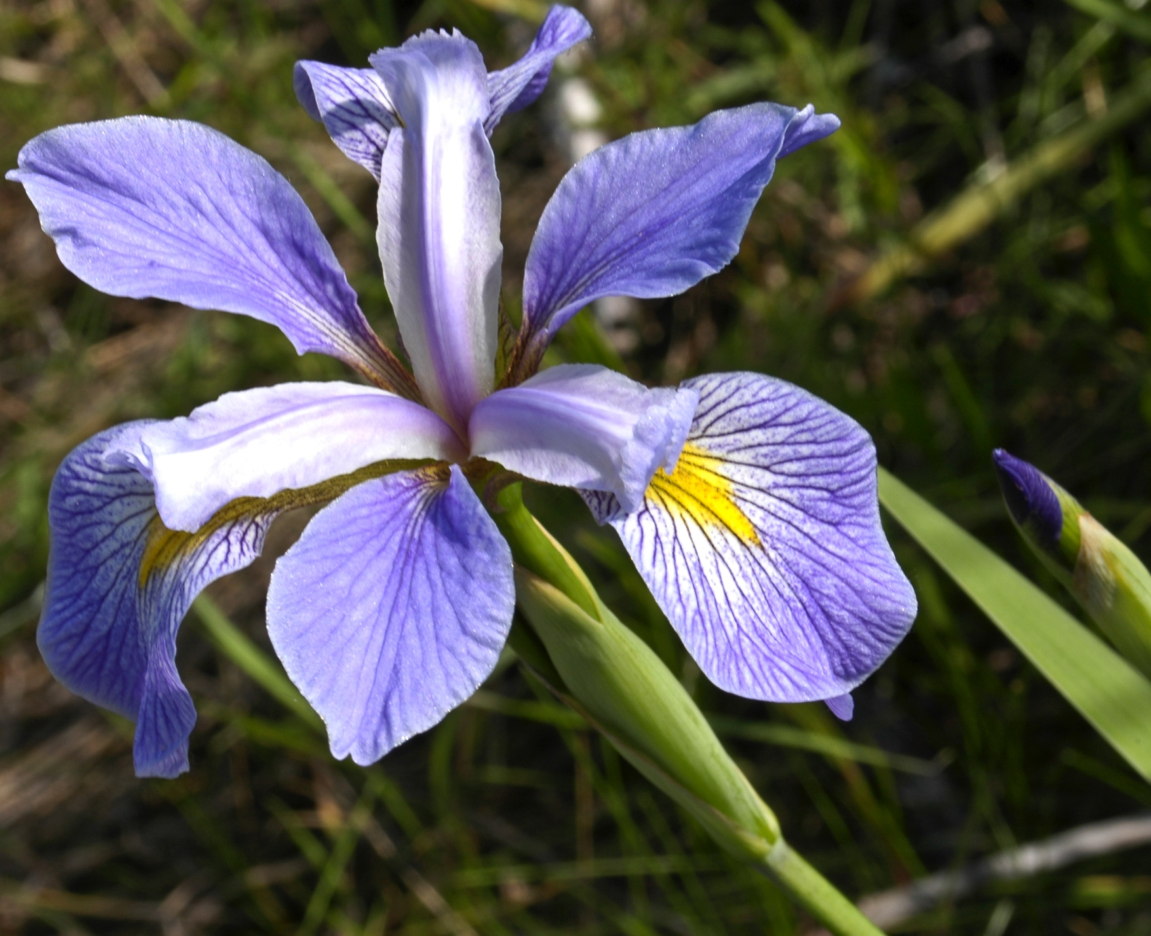
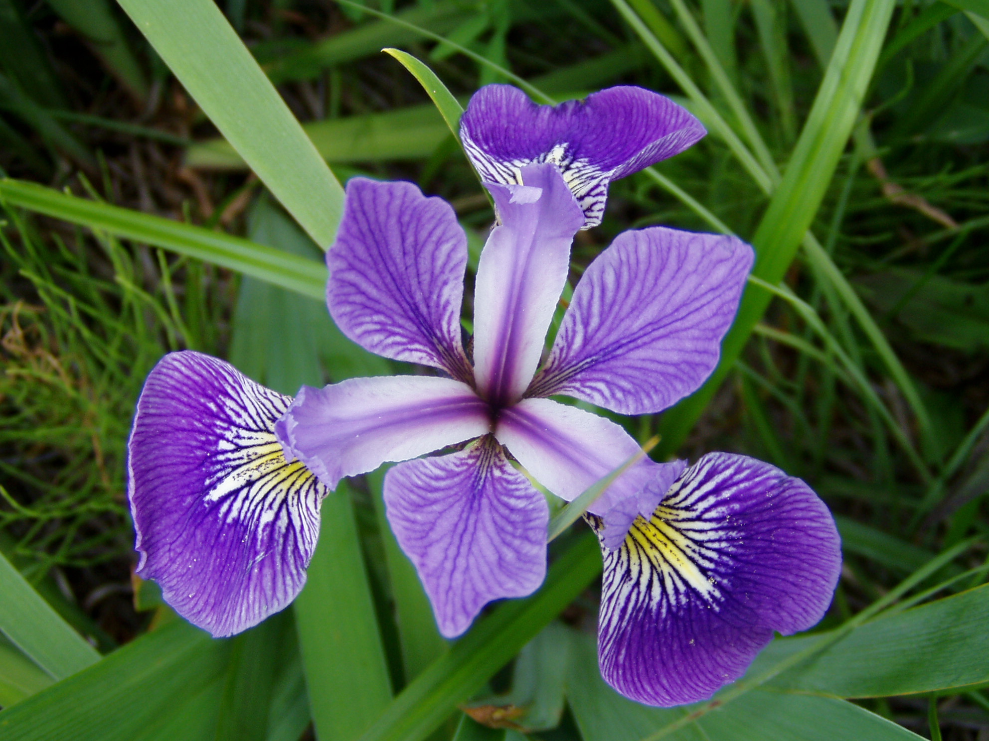
Classification Problem: An Example
Classify the Iris flower species: Iris setosa, Iris virginica and Iris versicolor
Color? Size? Height? Smell? Petal area?
-We analyze the new observation based on a set of quantifiable properties (features, attributes, explanatory variables)
-Different types of quantifiable properties
  -Categorical: “yellow”, “purple”, “green”
  -Ordinal: “large”, “medium”, “small”
  -Real-valued: 11.3 cm, 8.7 cm

Slide 3
Classification: General Steps
Observations / instances
Features / attributes
Training (usually offline)
Observations with know class information
Extract attributes / features
Learn a model using some algorithm
A model for this specific classification problem and classifier
Testing (usually online)
New observation with unknown class information
Extract attributes / features
Classifier algorithm
Predicted class information for this new observation

Slide 4
Classification: General Steps
Observations / instances
Features / attributes
Training (usually offline)
Observations with know class information
Extract attributes / features
Learn a model using some algorithm
A model for this specific classification problem and classifier
Sepal length: 1.3
Petal length: 2.1
…
“Iris virginica”
Testing (usually online)
New observation with unknown class information
Extract attributes / features
Classifier algorithm
Predicted class information for this new observation

Slide 5
Learn a model in Weka
Instances data = new Instances(inputReader);
data.setClassIndex(data.numAttributes() - 1);
Classifier ibk = new IBk();
ibk.buildClassifier(data);
Check Weka document for different classifier options
What is k in the above kNN classifier example?
http://weka.sourceforge.net/doc.dev/weka/classifiers/lazy/IBk.html

Slide 6
Classification: General Steps
Observations / instances
Features / attributes
Training (usually offline)
Observations with know class information
Extract attributes / features
Learn a model using some algorithm
A model for this specific classification problem and classifier
Testing (usually online)
New observation with unknown class information
Extract attributes / features
Classifier algorithm
Predicted class information for this new observation
“Iris versicolor”
Sepal length: 2.3
Petal length: 3.1
…
???

Slide 7
Classifier in Weka
Instances test = new Instances(inputReader);
test.setClassIndex(test.numAttributes() - 1);
for (int i = 0; i < test.numInstances(); i++) {
double pred = ibk.classifyInstance(test.instance(i));
…
Instances: an ordered set of instances
add(), delete(), numInstances()
Instance: represents a single instance

Slide 8
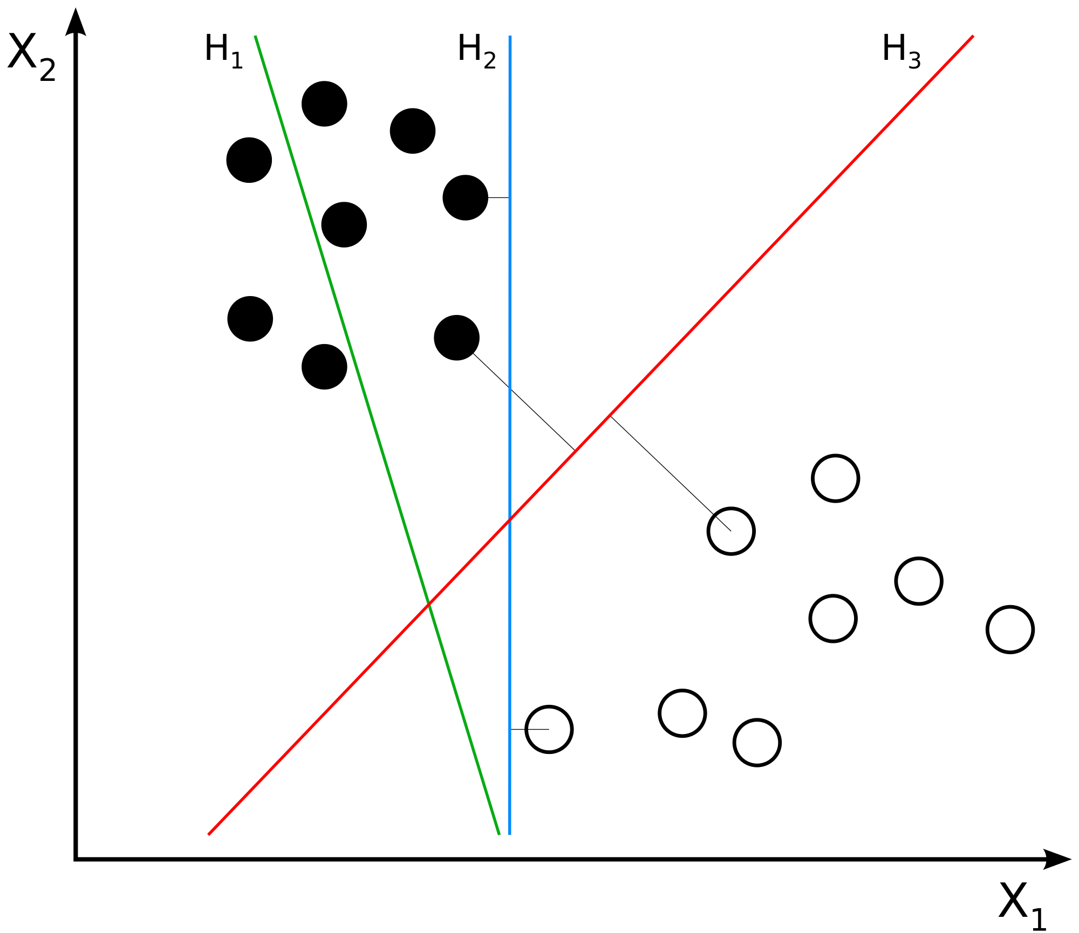
Support Vector Machine (SVM):
Another Example of Classifier Algorithm
Find the optimal separating hyperplane which maximizes the margin of the training data
1D: a point, 2D: a line, 3D: a plane, beyond 3D: a hyperplane
Feature space

Slide 9
Support Vector Machine (SVM):
Another Example of Classifier Algorithm
Model learning:
  Given the labeled training data, find the optimal hyperplane (model)
  A difficult problem: high-dimension feature vector, data not linearly separable, etc.
Classifier: Determine which side of the hyperplane the new observation falls on

Slide 10
SVM in Weka
// use libsvm.jar in Weka
WLSVM svmCls = new WLSVM();
svmCls.buildClassifier(data);
// svmCls can be used to classify new instances
The public methods of the svm classifier are similar: buildClassifier(), classifyInstance(), etc.

